Slide 1
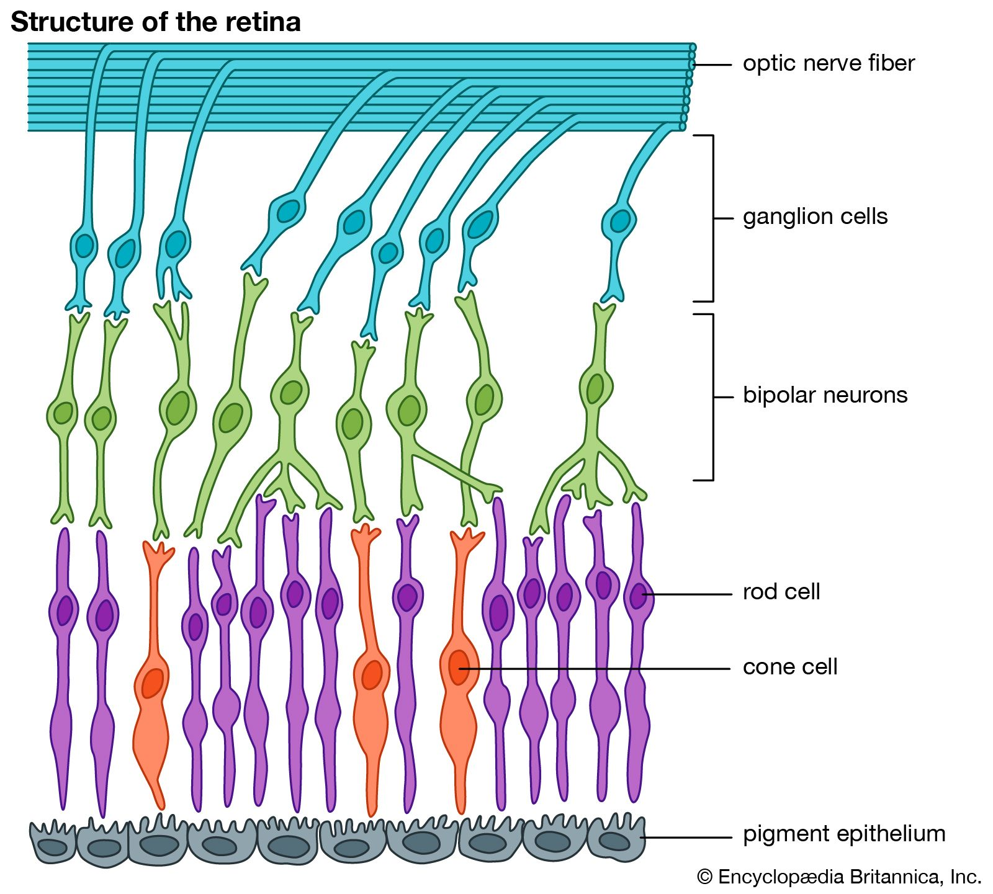

Slide 3
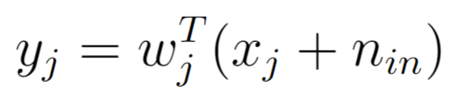
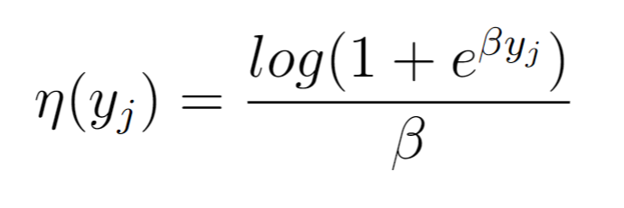
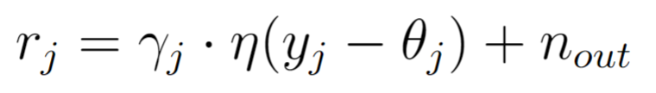
Forward model in 3 easy steps
1- Linear weighted inputs
2- Softplus output nonlinearity
3- Gain and threshold

Slide 4
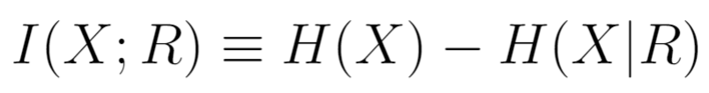
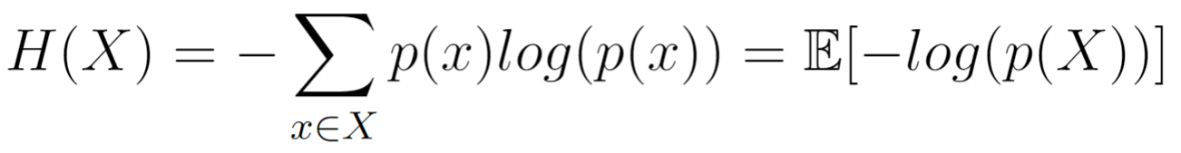
Maximizing mutual information

Slide 5
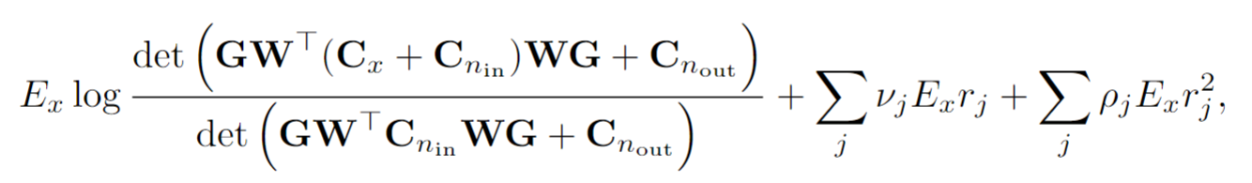
Firing rate constraint – Lagrange multipliers

Slide 6





Example RFs
However, colors can be misleading!
Solution: Radial averages

Slide 7
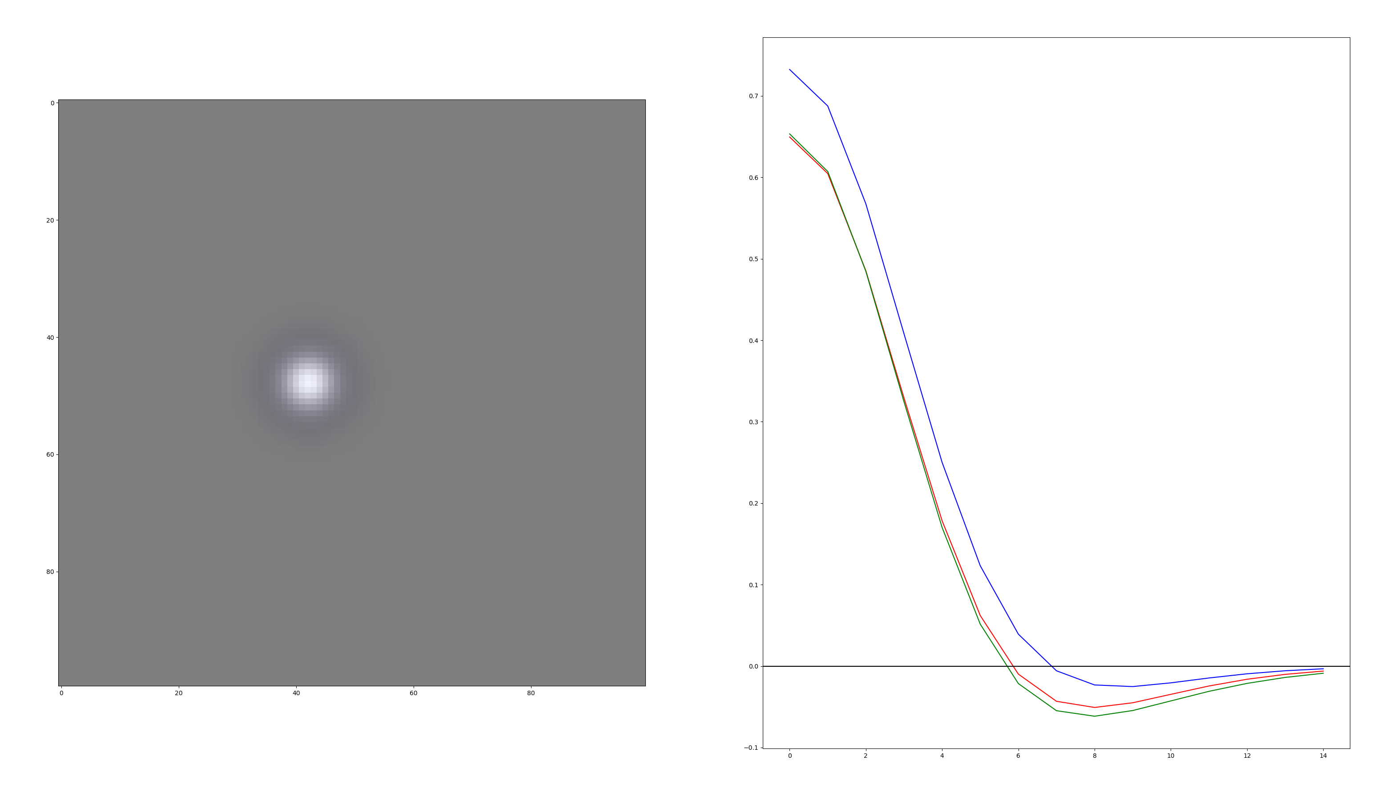

Slide 8
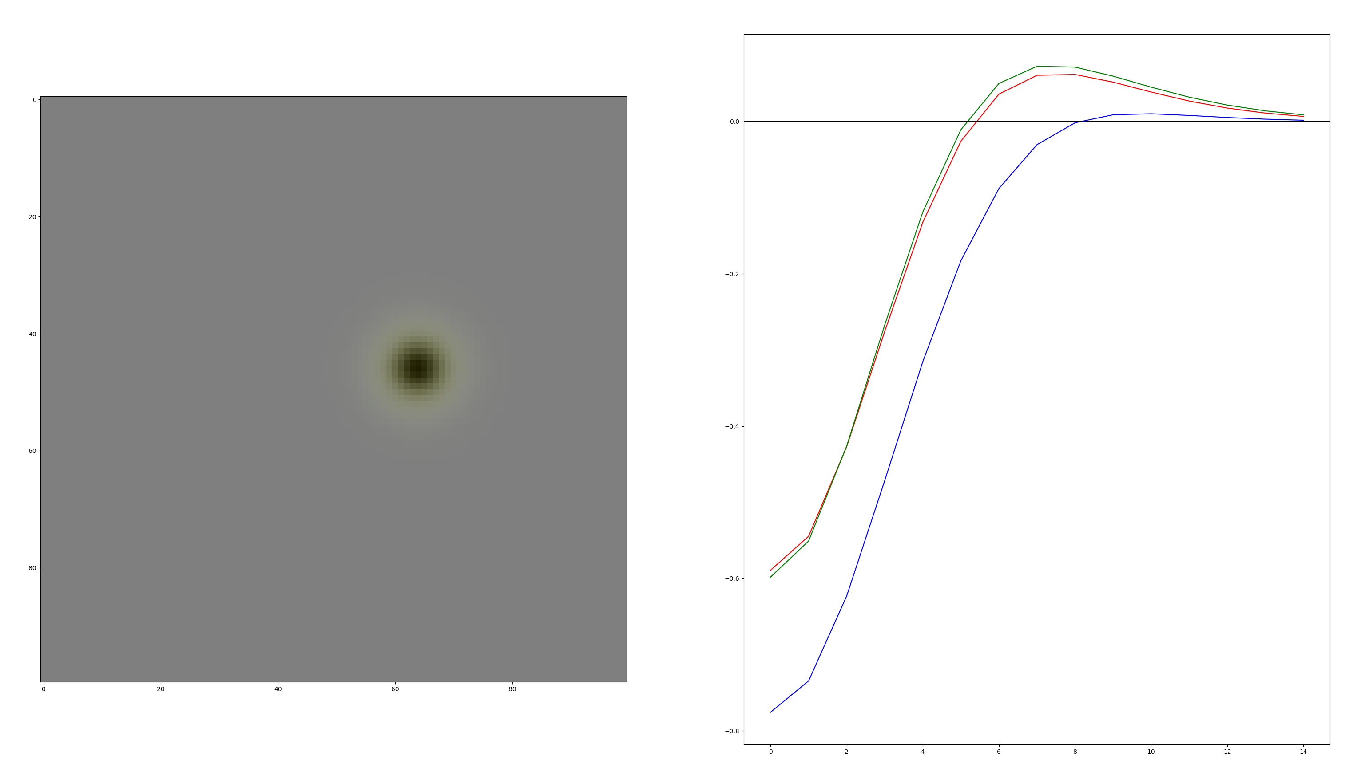

Slide 9
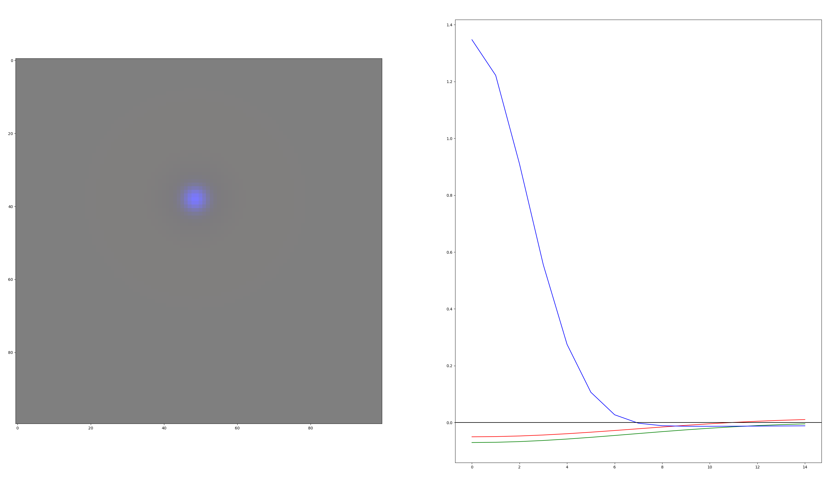

Slide 10
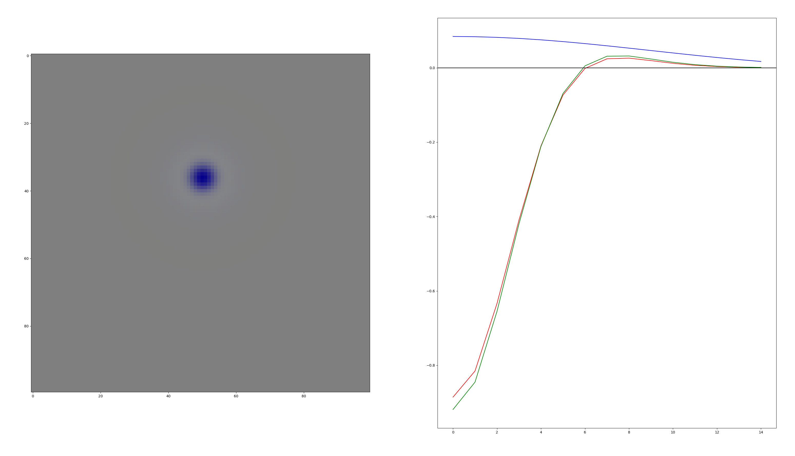

Slide 11
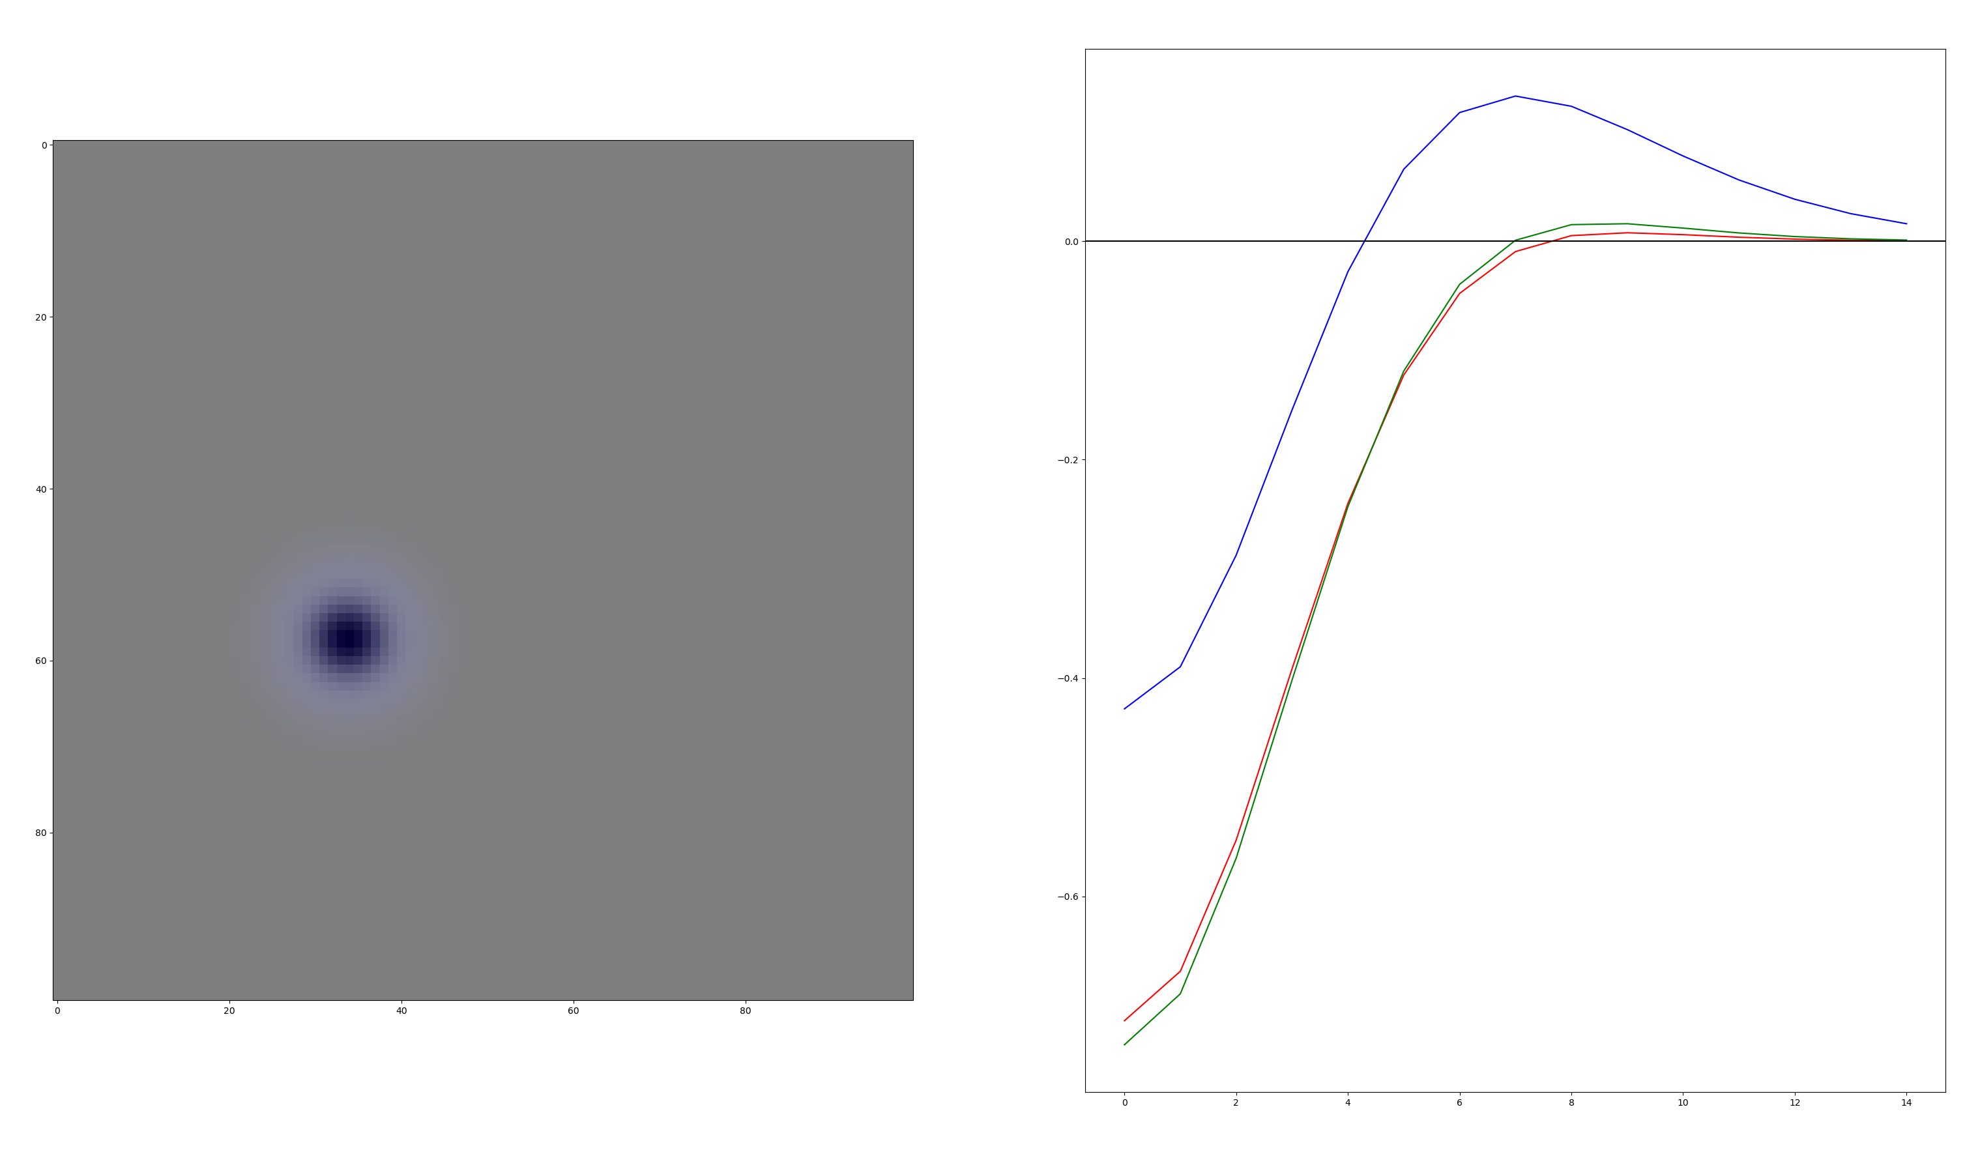

Slide 12
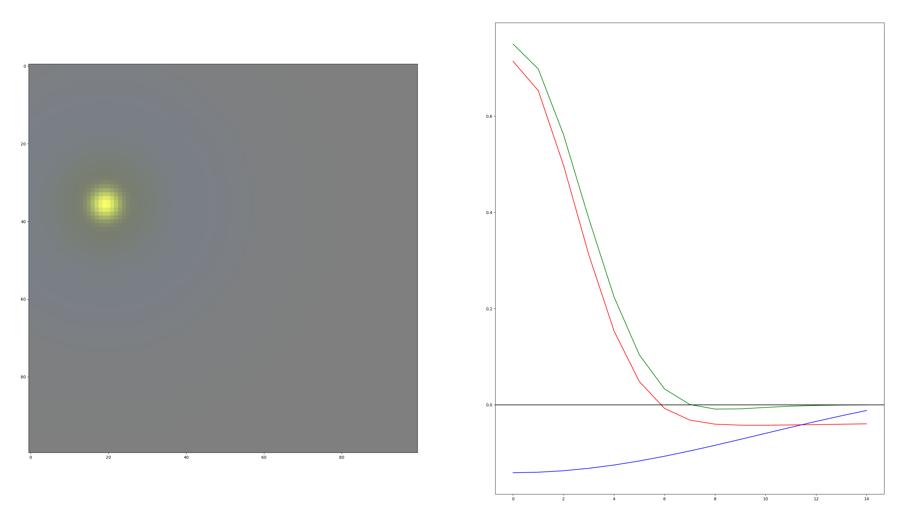

Slide 13
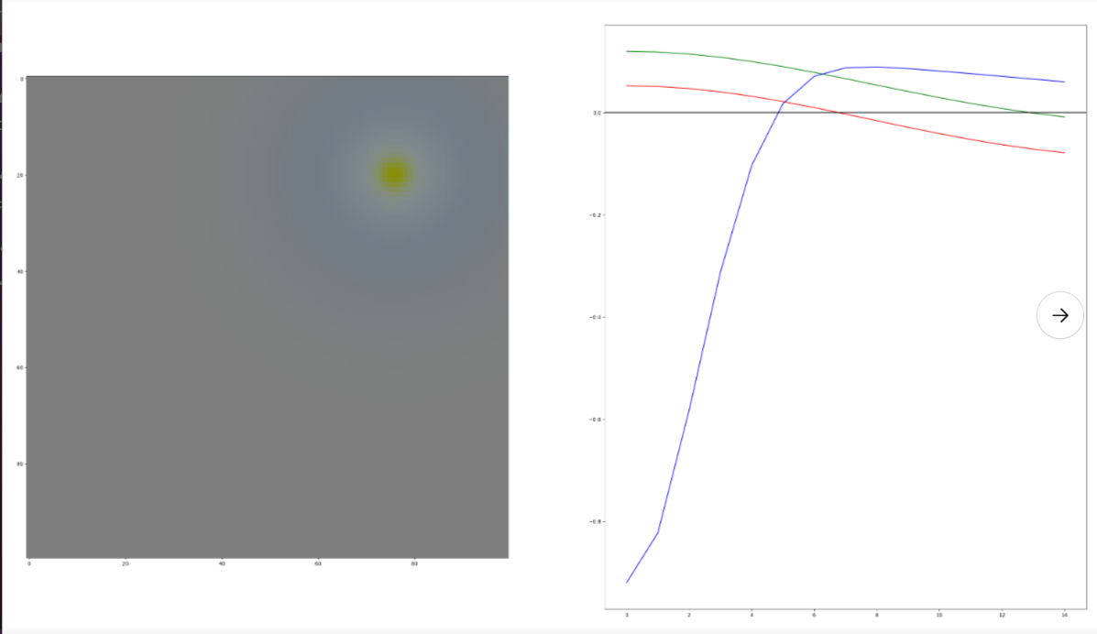
This neuron doesn’t exist in vivo; but there are only 2 of them out of 300

Slide 14
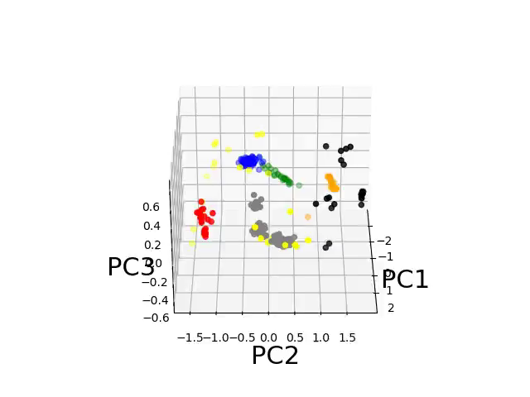
Classifying populations based on their first 3 PCs - Control

Slide 15

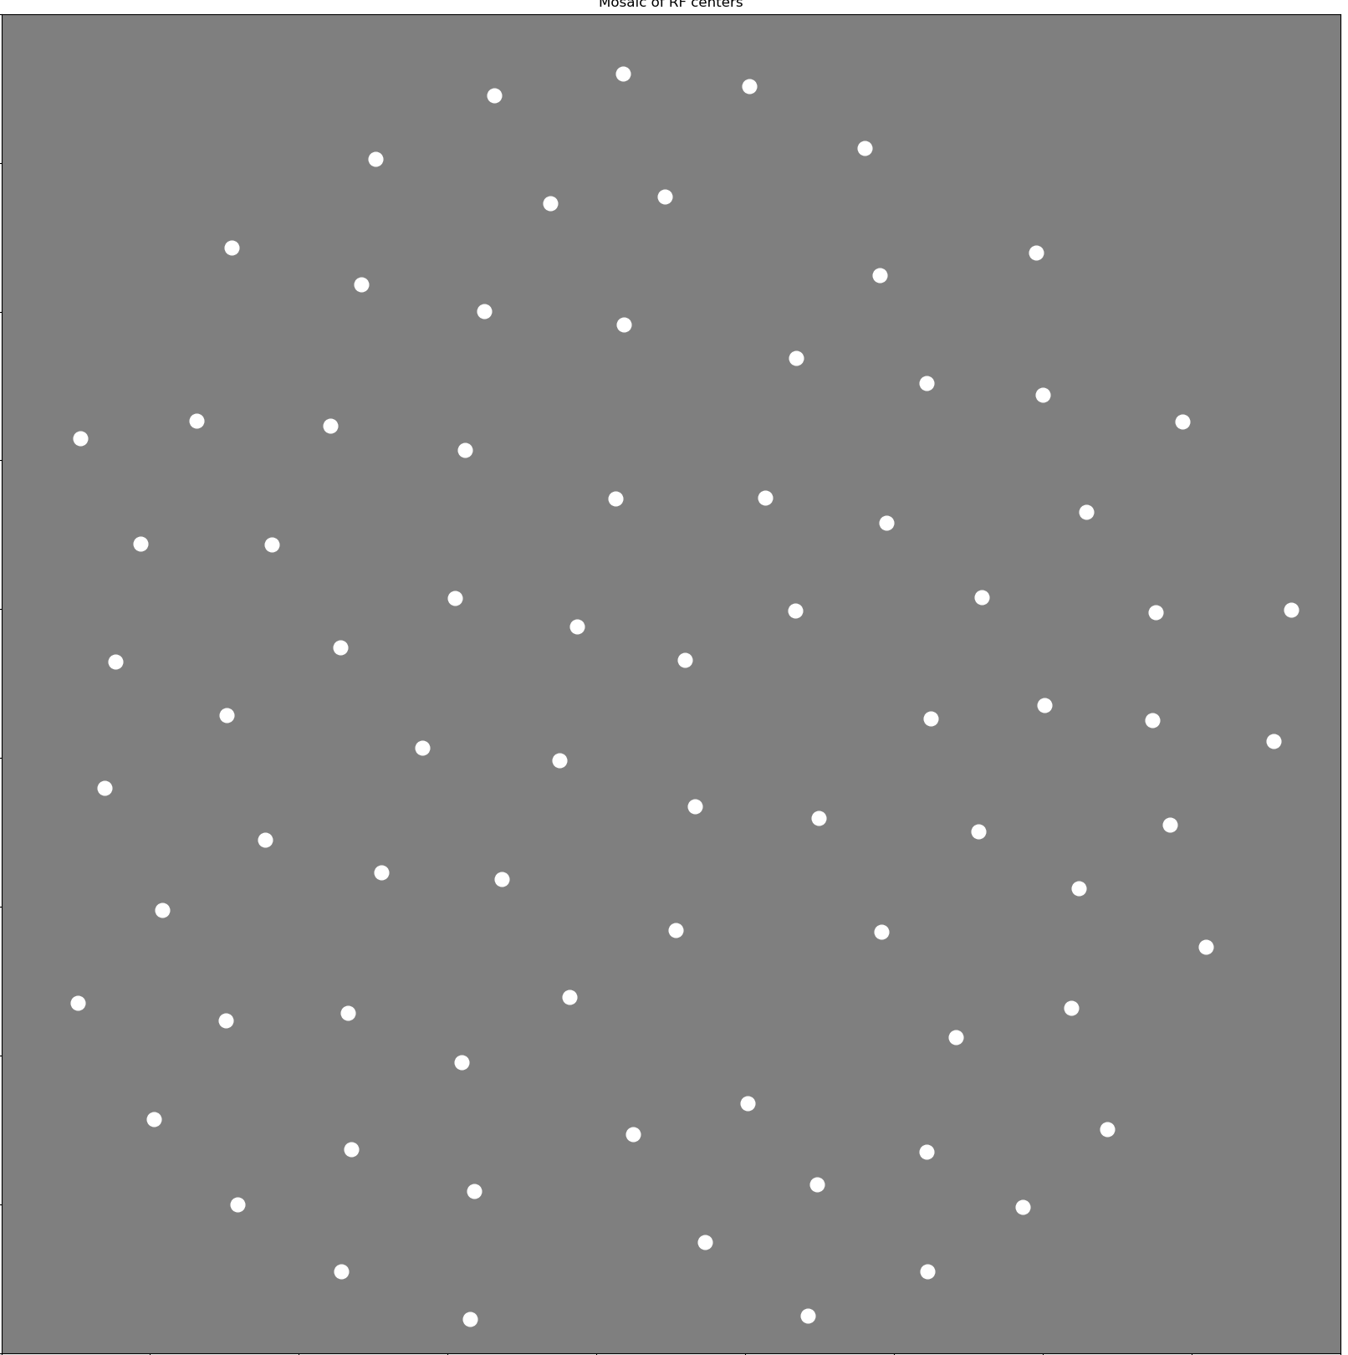
Some of these mosaics look good

Slide 16


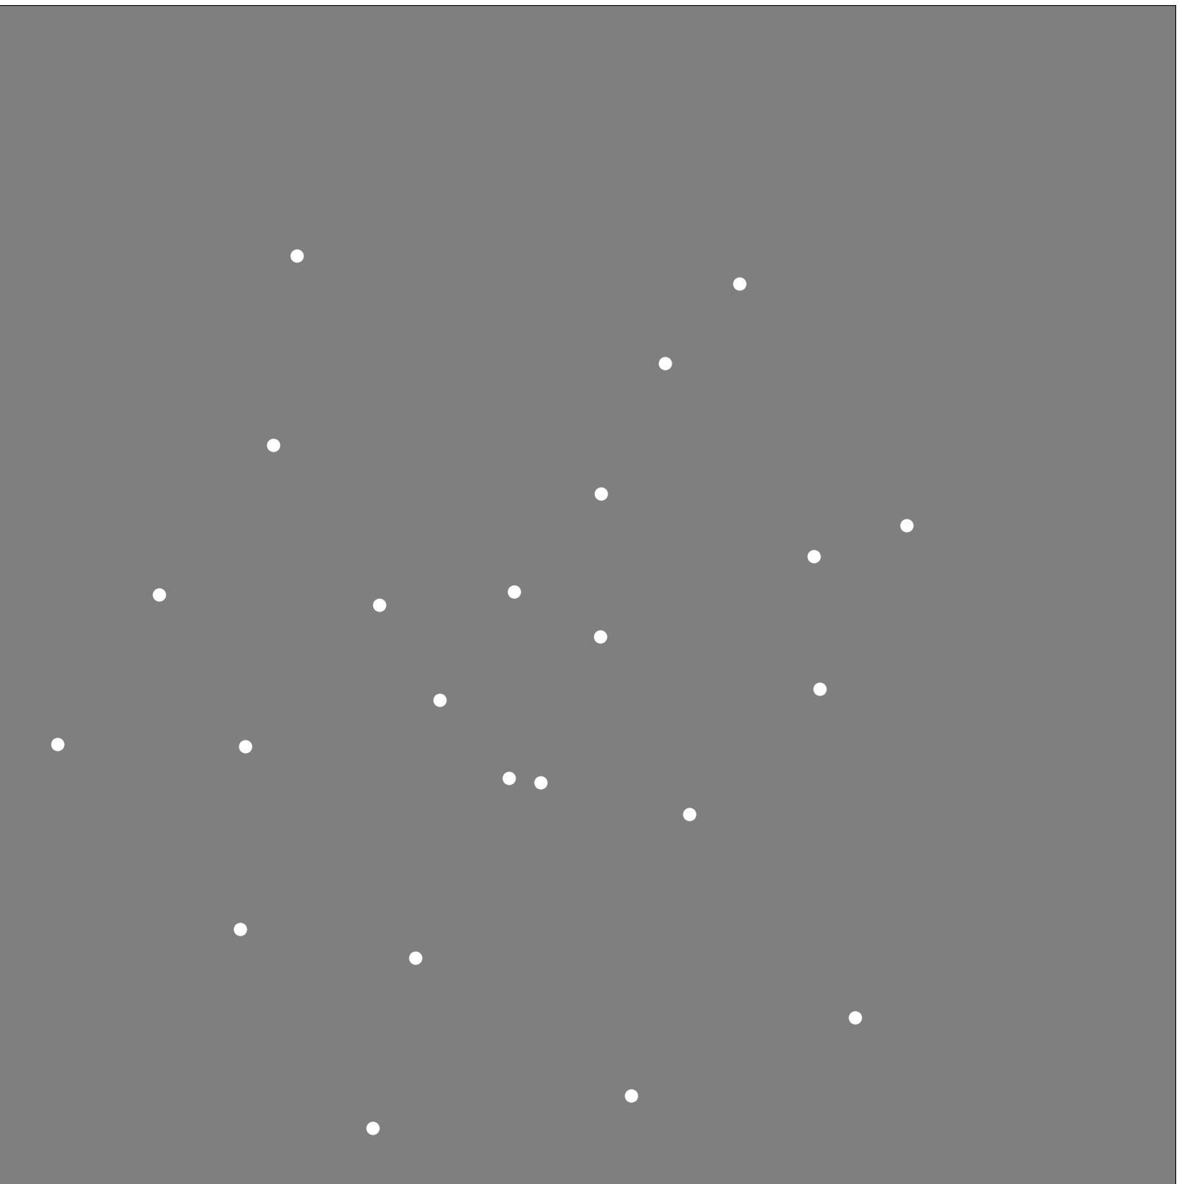
Others… not so good

